Slide 1
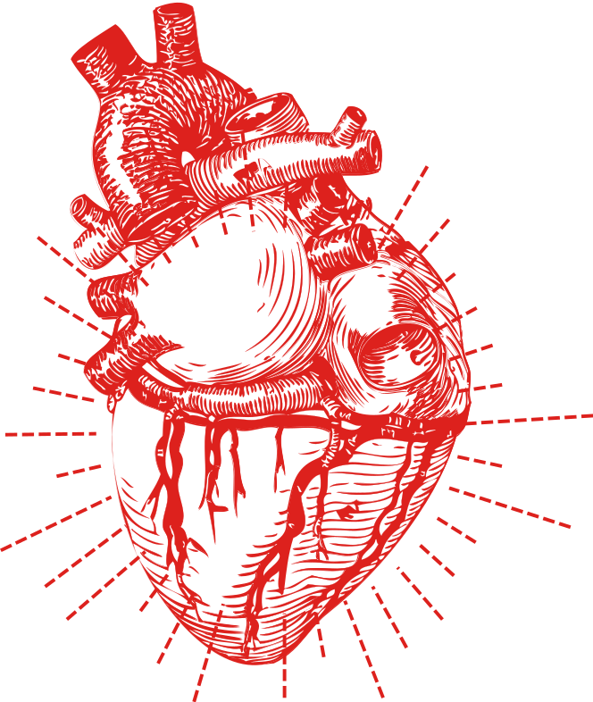
SYRACUSE UNIVERSITY
IST 707 | M402 DATA MINING
Predicting
Heart Disease
By Jake Arluck, Laura Larregui, Jacqueline Parks, and Courtney Rowland

Slide 2
Composition of the Patients
High Risk
45.7%
Low Risk
54.3%

Slide 3
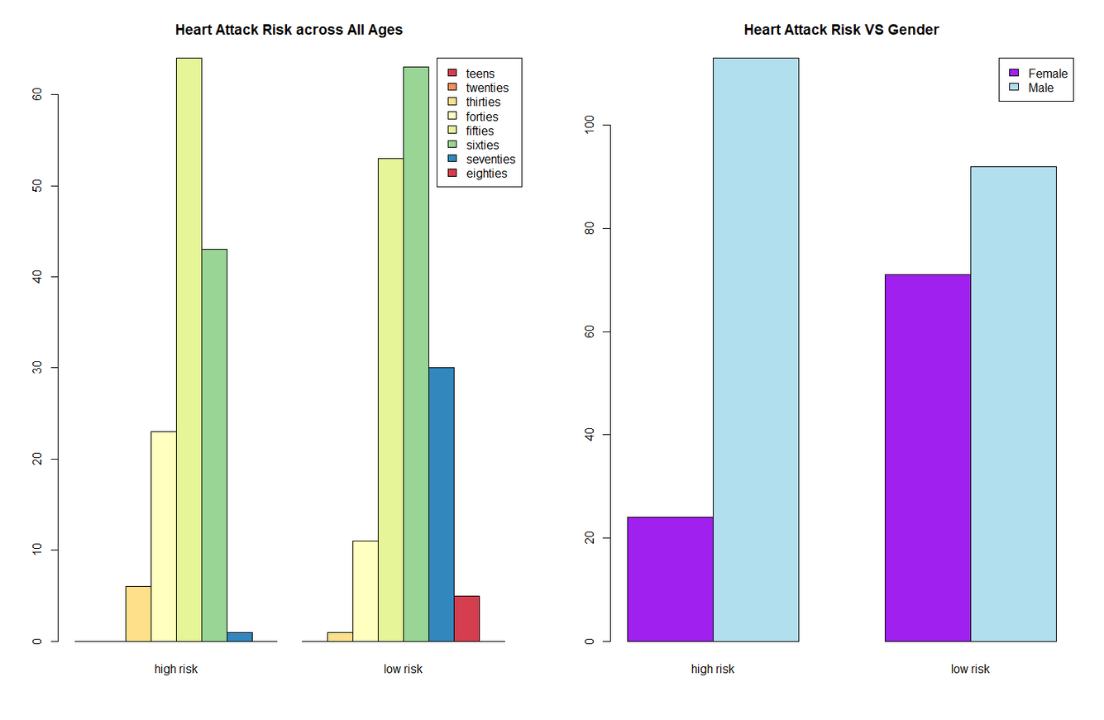
Exploratory Data Analysis
Variables: Age + Sex
Males and people between their 50s and 60s have a higher risk of heart disease.

Slide 4
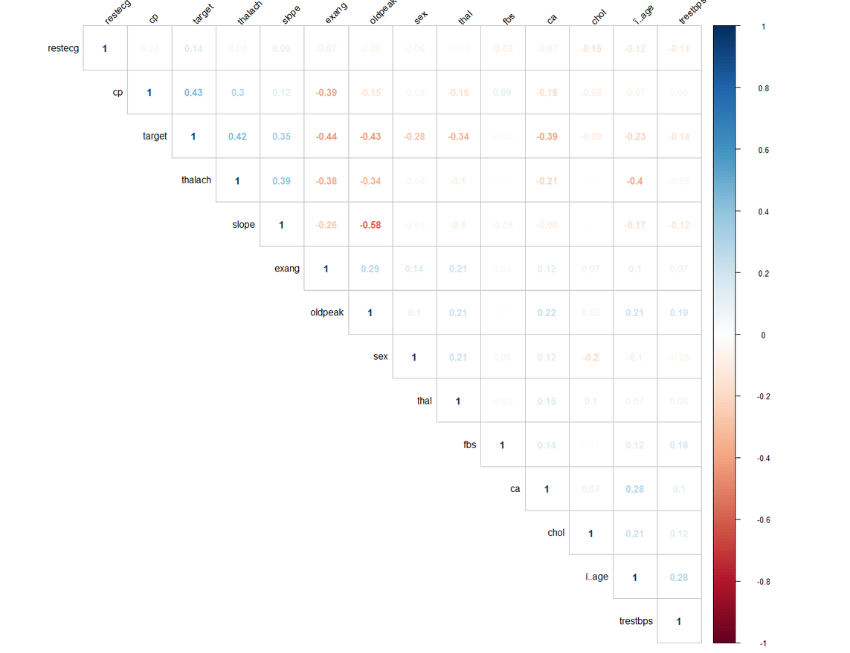
Correlation Matrix
Positive correlations are displayed in blue and negative correlations in red color.
Significant Positive Correlations: thalach, slope, cp
Significant Negative Correlations: exang, oldpeak, ca
Notes:
Our strongest positive correlations exist between our target (risk of heart disease) and cp (existence of chest pain). Other strong positive correlations include our target and maximum heart rate achieved, as well as maximum heart rate achieved and the slope of the peak exercise ST segment. Our strongest negative correlation includes the slope of the peak exercise ST segment and the ST depression induced by exercise relative to rest.

Slide 5
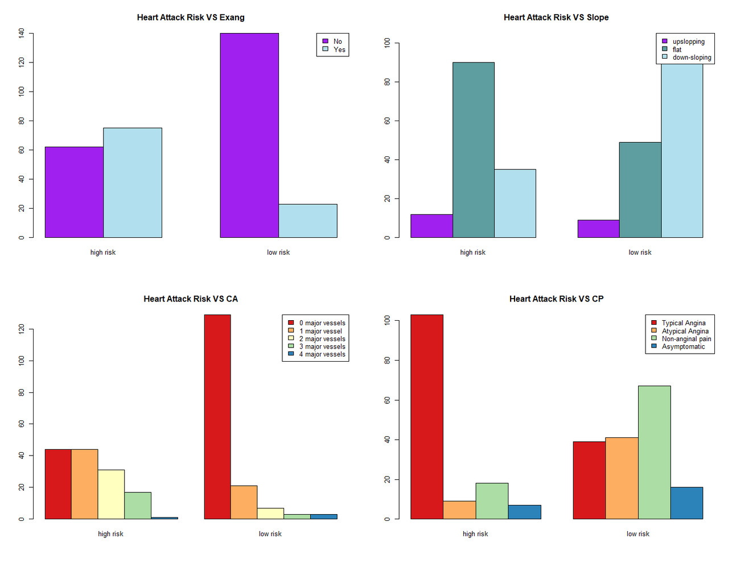
Variables with significant correlation
People with higher heart disease risk have:
Exercise induced angina
A flat slope
0-1 major vessels colored by fluoroscopy
Typical Angina

Slide 6

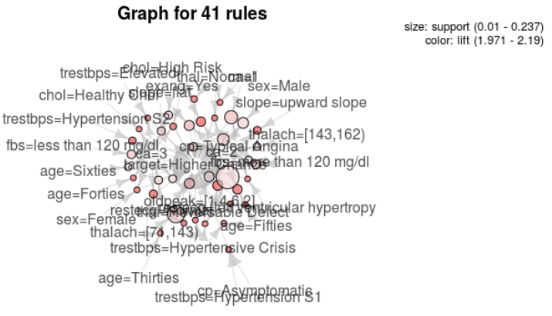
ARM
Plot of total rules mined. Many descriptive variables can be seen visually that contribute to a target patient with high risk for heart disease such as those whose cholesterol level is considered ‘High Risk’, male, ages forties/fifties/sixties, and have a resting blood pressure considered to be in hypertensive crisis upon hospital admission.

Slide 7
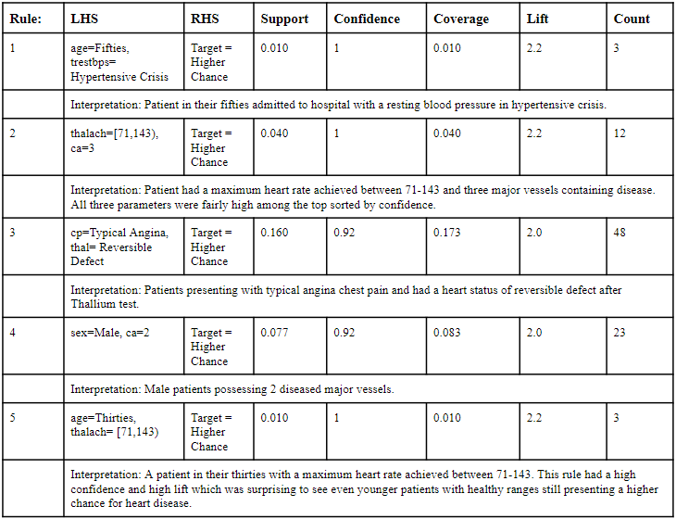
ARM: Top 5 Interesting Rules

Slide 8
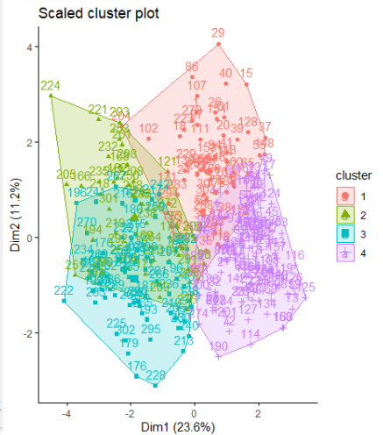
K-Means Clustering / PCA
K = 3, 4, 5 all good results
Good separation between clusters
Necessary to normalize data
Top 2 dimensions: ~⅓ of total variance.
Largest dimension corresponds very closely to overall risk - suggests existence of a “general factor of heart disease.”
2nd dimension roughly corresponds to diabetes.
High risk
Low risk

Slide 9

Clustering Insights
What can we say about low-risk and high-risk clusters?
Cluster 4 has expected low-risk traits: more female, younger, low diabetes, low cholesterol.
Cluster 1 (low-medium risk) surprising: high cholesterol, ⅓ diabetic, but direct heart diagnostics (e.g. ST depression during exercise) are good. May reflect diabetics given good treatment, or else people with good genetic resistance despite unhealthy lifestyles.
Cluster 3 (highest risk) skews male (81%), but is moderate in terms of cholesterol, diabetes.
Cluster 2 (2nd highest risk) is more typical: high cholesterol, bad blood sugar, elevated exercise heart rate.
Do we need to rethink the role of cholesterol and diabetes in heart disease risk prognosis?

Slide 10
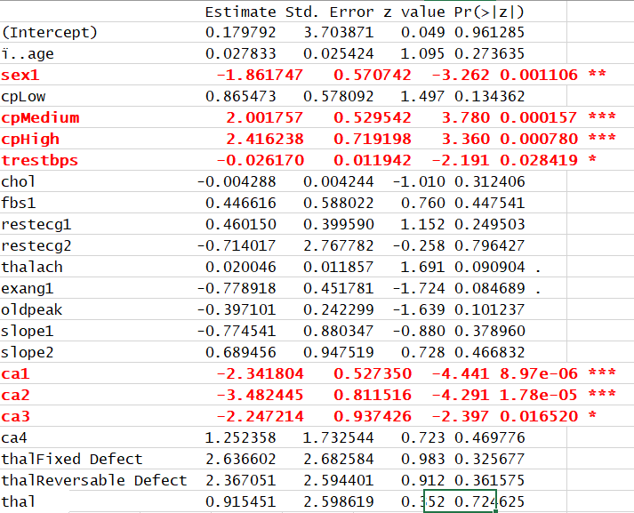
Logit Regression
Simple models not very successful - we need data science!
Only a few variables significant at the p < .05 level with a traditional logit regression.
Sex, resting blood sugar, number of affected arteries, level of chest pain.
We knew this!
The other variables may have valuable insight even if they are not significant with traditional testing.

Slide 11

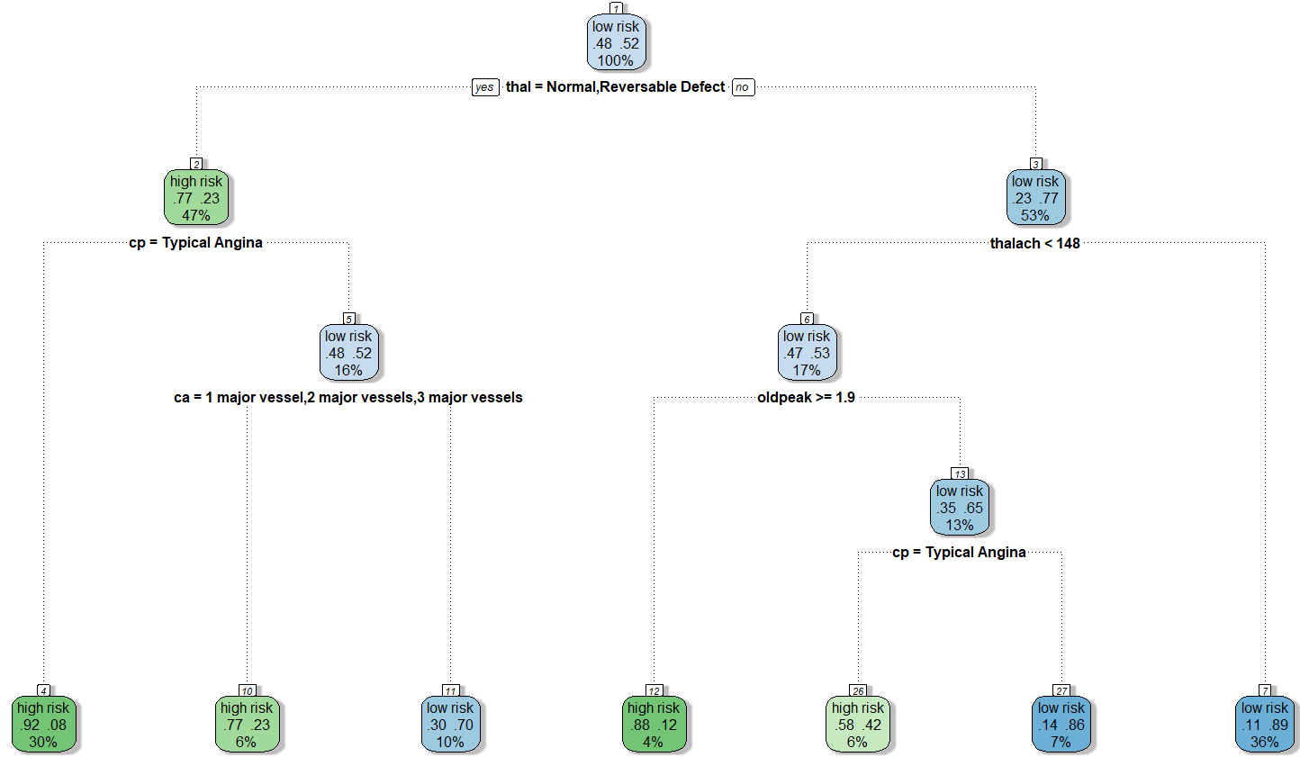
Decision Trees
1
Accuracy 80%

Slide 12



88% FBS < 120 mg/d
Naïve Bayes
79% Males
75% Typical Angina
68% Reversible Defect (Thallium Test)
67% Flat Slope
57% High Cholesterol
Accuracy 85 %
44% Fifties

Slide 13
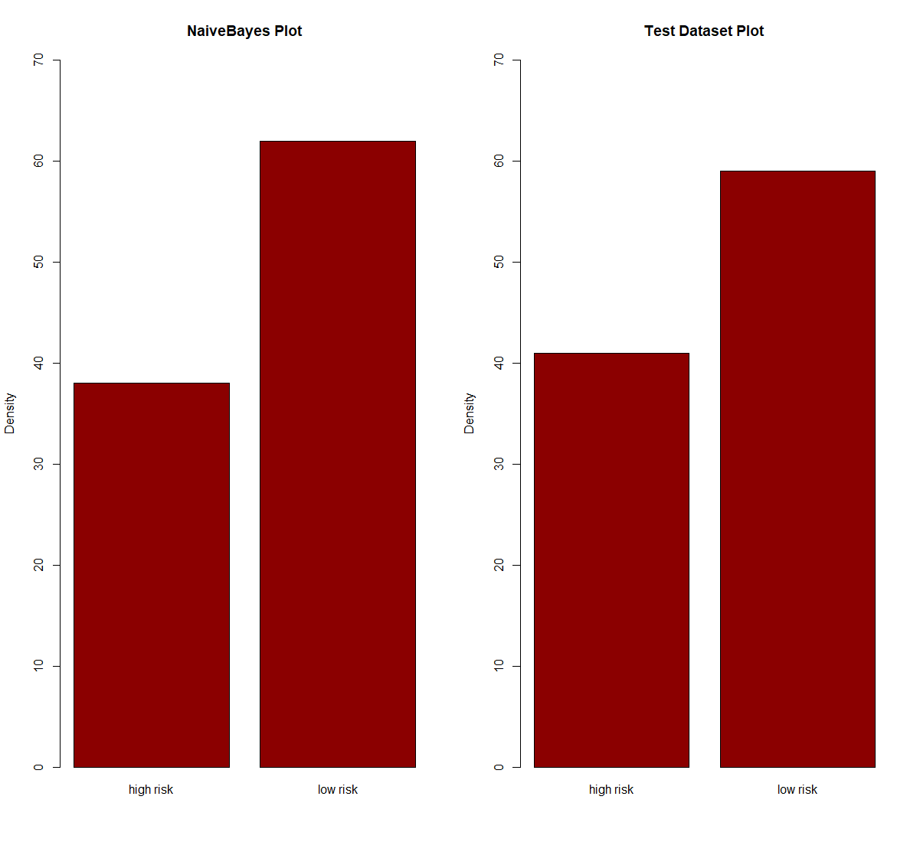
Naïve Bayes VS Test Dataset

Slide 14
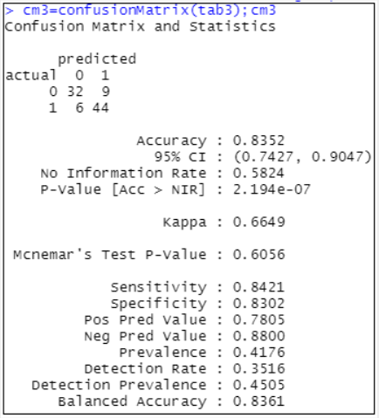
Random Forest
When running a random forest classification algorithm, we set the seed at five. Our confusion matrix resulted in a prediction accuracy of 83.52%. That is, 76 out of our 91 test data points were predicted correctly.

Slide 15
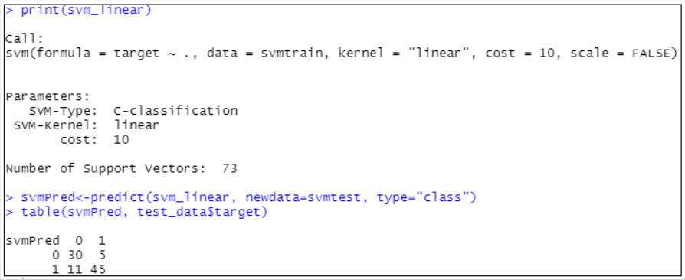
Support Vector Machine
Our support vector machine model was run using a linear kernel. The model had an accuracy of 82.42%. That is, it correctly predicted 75 out of 91 test data points. This was just one fewer correct prediction than our random forest model.

Slide 16

Model Comparison
ARM
Naïve Bayes
Significant attributes: sex, age, trestbps, thalach, ca, cp
Accuracy: 85%
Significant attributes: Blood Sugar Levels, Sex, and Chest Pain
Clustering
Random Forest
Main axes: overall heart disease risk, diabetes risk,
Accuracy: 83.52%:
Decision Trees
SVM
Accuracy: 80%
Significant attributes: Thallium Test Status, and Chest Pain
Accuracy: 82.42% (only one less correct prediction compared to random forest)

Slide 17
Heart Disease Risk
People with higher risk of getting heart disease have the following qualities
Males
Age: 50s -60s
Typical Angina
Diabetes

Slide 18




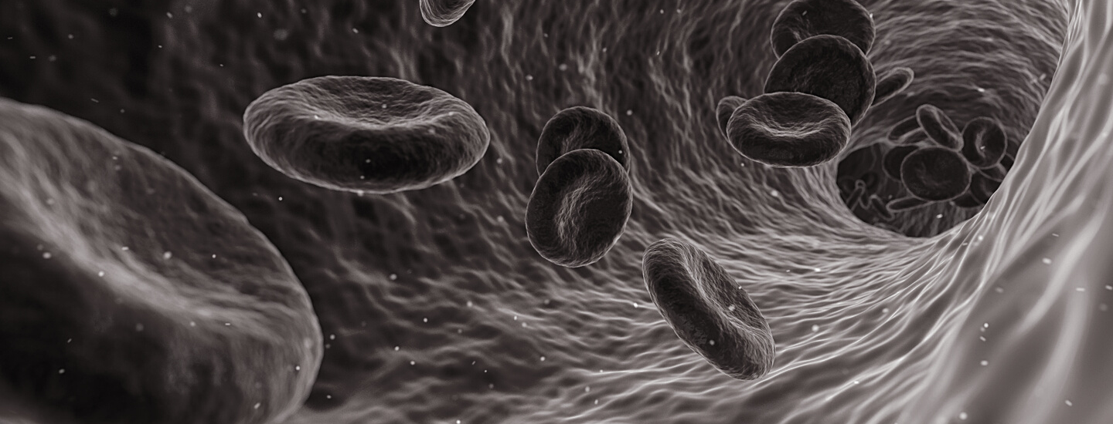
Questions?

Slide 19

Data Dictionary
Category | Name | Type | Description
Patient Demographic | Age | Continuous | Patient’s age; Population ranges from 29 to 77 years old
 | Sex | Categorical with 2 levels | 0 = Female; 1 = Male
Patient Vitals | Chest Pain (cp) | Categorical with 4 levels | 0: Typical angina, 1: Atypical angina, 2: Non-anginal pain, 3: Asymptomatic
 | Resting Blood Pressure (trestbps) | Continuous | In mmHg upon hospital admission
 | Cholesterol (chol) | Continuous | Serum cholesterol in mg/dl
 | Fasting Blood Sugar (fbs) | Categorical with 2 levels | Fasting blood sugar >120 mg/dl (True, False)
 | Resting Electrocardiographic (restecg) | Categorical with 3 levels | Resting electrocardiographic results ( normal 0, Level 1, Level 2)
 | Maximum Heart Rate Achieved (thalach) | Continuous
 | Exercise Induced Angina (exang) | Categorical with 2 levels | 0 = No, 1 = Yes
 | Oldpeak | Continuous | ST depression caused by exercise
 | Slope | Categorical with 3 levels | Up 0, Down 1, Flat 2
 | Number of Major Vessels (ca) | Categorical with 4 levels | (0-3) colored via fluoroscopy
 | Thallium test (thal) | Categorical with 3 levels | Heart status retrieved from Thallium test (0 Normal, 1 Fixed Defect, 2 Reversible defect)
Goal | Target (heart disease risk) | Categorical with 2 levels | 0: Higher chance, 1: Lower chance
Notes:
The original data set contained 76 attributes; but the Kaggle data set only includes 14 of these. We tried to look for the original data set but could not access it. So, these 14 variables are the ones which are most important to interpreting the data. They include age, gender, whether the patient has had any chest pains, their resting blood pressure on hospital admission, their cholesterol, whether they have a fasting blood sugar over 120 (which would indicate diabetes), whether they have a normal or irregular ECG, their maximum heart rate during an exercise stress test, whether they exhibit exercise-induced angina (chest pain), the peak of the ST depression caused by exercise, the slope of the peak exercise ST segment (ST segment depression can indicate myocardial ischemia), the number of major vessels colored by fluoroscopy (meaning containing disease), evidence of disease in a thallium test, and our target variable (presence of heart disease).

